Slide 1
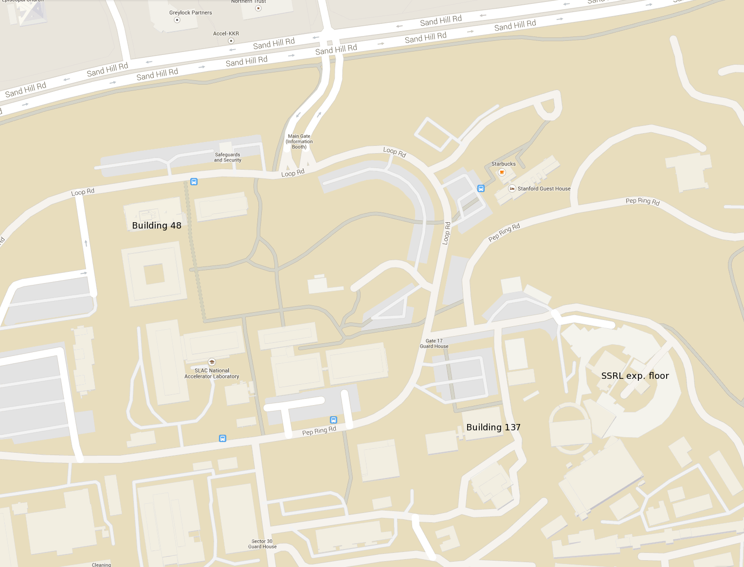
Site Map for the RapiData Tutorials 19-20 April 2017
Workshop to be held in the ROB Conference Rooms A/B/C/D
Note: All Lunches and Dinners will be served here.
To the Redwood Conference Rooms
To the RapiData Tutorials

Slide 2
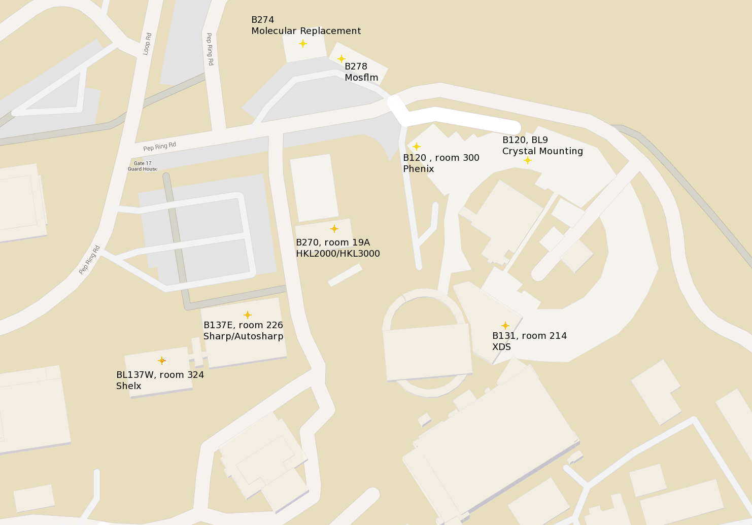
Site Map for the RapiData Tutorials 19-20 April 2017
B274 Conf. Room
Molecular Replacement
B278 Rm104
Shelx
SSRL Beam Lines:
7-1, 9-2, 12-2,
11-1, 14-1
Gate 17
B452
Rm101 CCP4/DIALS Rm103 XDS
B120 Rm300
Phenix
(3rd Floor)
B270 - HKL
SSRL Admin Buildings
B130 Rm214
SAXS
SSRL Admin Buildings
To the Redwood Conference Rooms
To the RapiData Tutorials

